Slide 1
Item 9/doc 9.1/(1) – Co-sponsored programmes
Third Session of the Infrastructure Commission
(INFCOM-3, 15-19 April 2024)
Thelma Krug/ Global Climate Observing System (GCOS) Chair
18 April 2024

Slide 2
Content
1 GCOS the programme
2 GCOS main activities and outputs
3 GCOS and contributing networks
4 GCOS and INFCOM

Slide 3
GCOS the programme (I)
GCOS was established in 1992 to address the UNFCCC systematic observation agenda
GCOS
Steering Committee
GCOS is a Co-Sponsored Programme:
WMO
IOC - UNESCO
UNEP
ISC
GCOS
Secretariat
GCOS is governed by a Steering Committee and has 3 panels of experts: AOPC, OOPC, TOPC
Additional contributors:
EU Commission, US State Dept., NOAA, Germany, EUMETSAT
Atmospheric Observation
Panel for Climate (AOPC)
Ocean Observations Physics and Climate Panel (OOPC)
Terrestrial Observation
Panel for Climate (TOPC)
GCOSWCRPGOOS
GCOSWCRP
GCOSWCRP

Slide 4
GCOS the programme (II)
GCOS works towards climate observations being enhanced and sustained into the future, to provide the evidence needed to understand and predict the evolution of the climate, to guide mitigation and adaptation measures, to assess risks and enable attribution of climatic events to underlie causes, and to underpin climate services.
GCOS = Climate observations enabling climate science and services

Slide 5
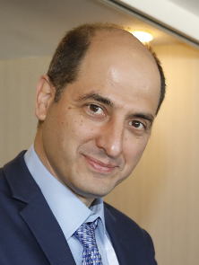
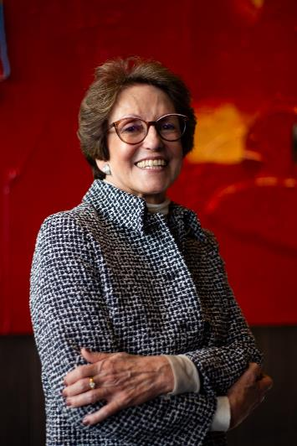
GCOS the programme (III)
Director of the GCOS Secretariat
Mr Nir Stav
Director of WMO Infrastructure Department
Chair of GCOS Steering Committee
Ms Thelma Krug
INPE, National Institute for Space Research of Brazil
Terrestrial Observation
Panel for Climate (TOPC)

Slide 6
Networks contributing to GCOS
Atmospheric/WMO related networks, like:
GSN, GUAN, GRUAN, GBON, GAW
a number of different ocean
climate-related networks, in
collaboration with GOOS
Other Global Organiza-tions and Networks for specific terrestrial ECV
Satellite observations are coordinated by the Joint CEOS/CGMS Working Group on Climate
Examples of global networks associated with GCOS
and a wide range of other partners who support GCOS, host data centres, etc
Examples of national and regional networks

Slide 7
Networks contributing to GCOS
Atmospheric/WMO related networks, like:
GSN, GUAN, GRUAN, GBON, GAW, GCW
a number of different ocean
climate-related networks, in
collaboration with GOOS
Other Global Organiza-tions and Networks for specific terrestrial ECV
Satellite observations are coordinated by the Joint CEOS/CGMS Working Group on Climate
Examples of global networks associated with GCOS
GSN, GUAN, GRUAN and GSRN directly supported by GCOS (GCOS networks)
and a wide range of other partners who support GCOS, host data centres, etc
Examples of national and regional networks

Slide 8
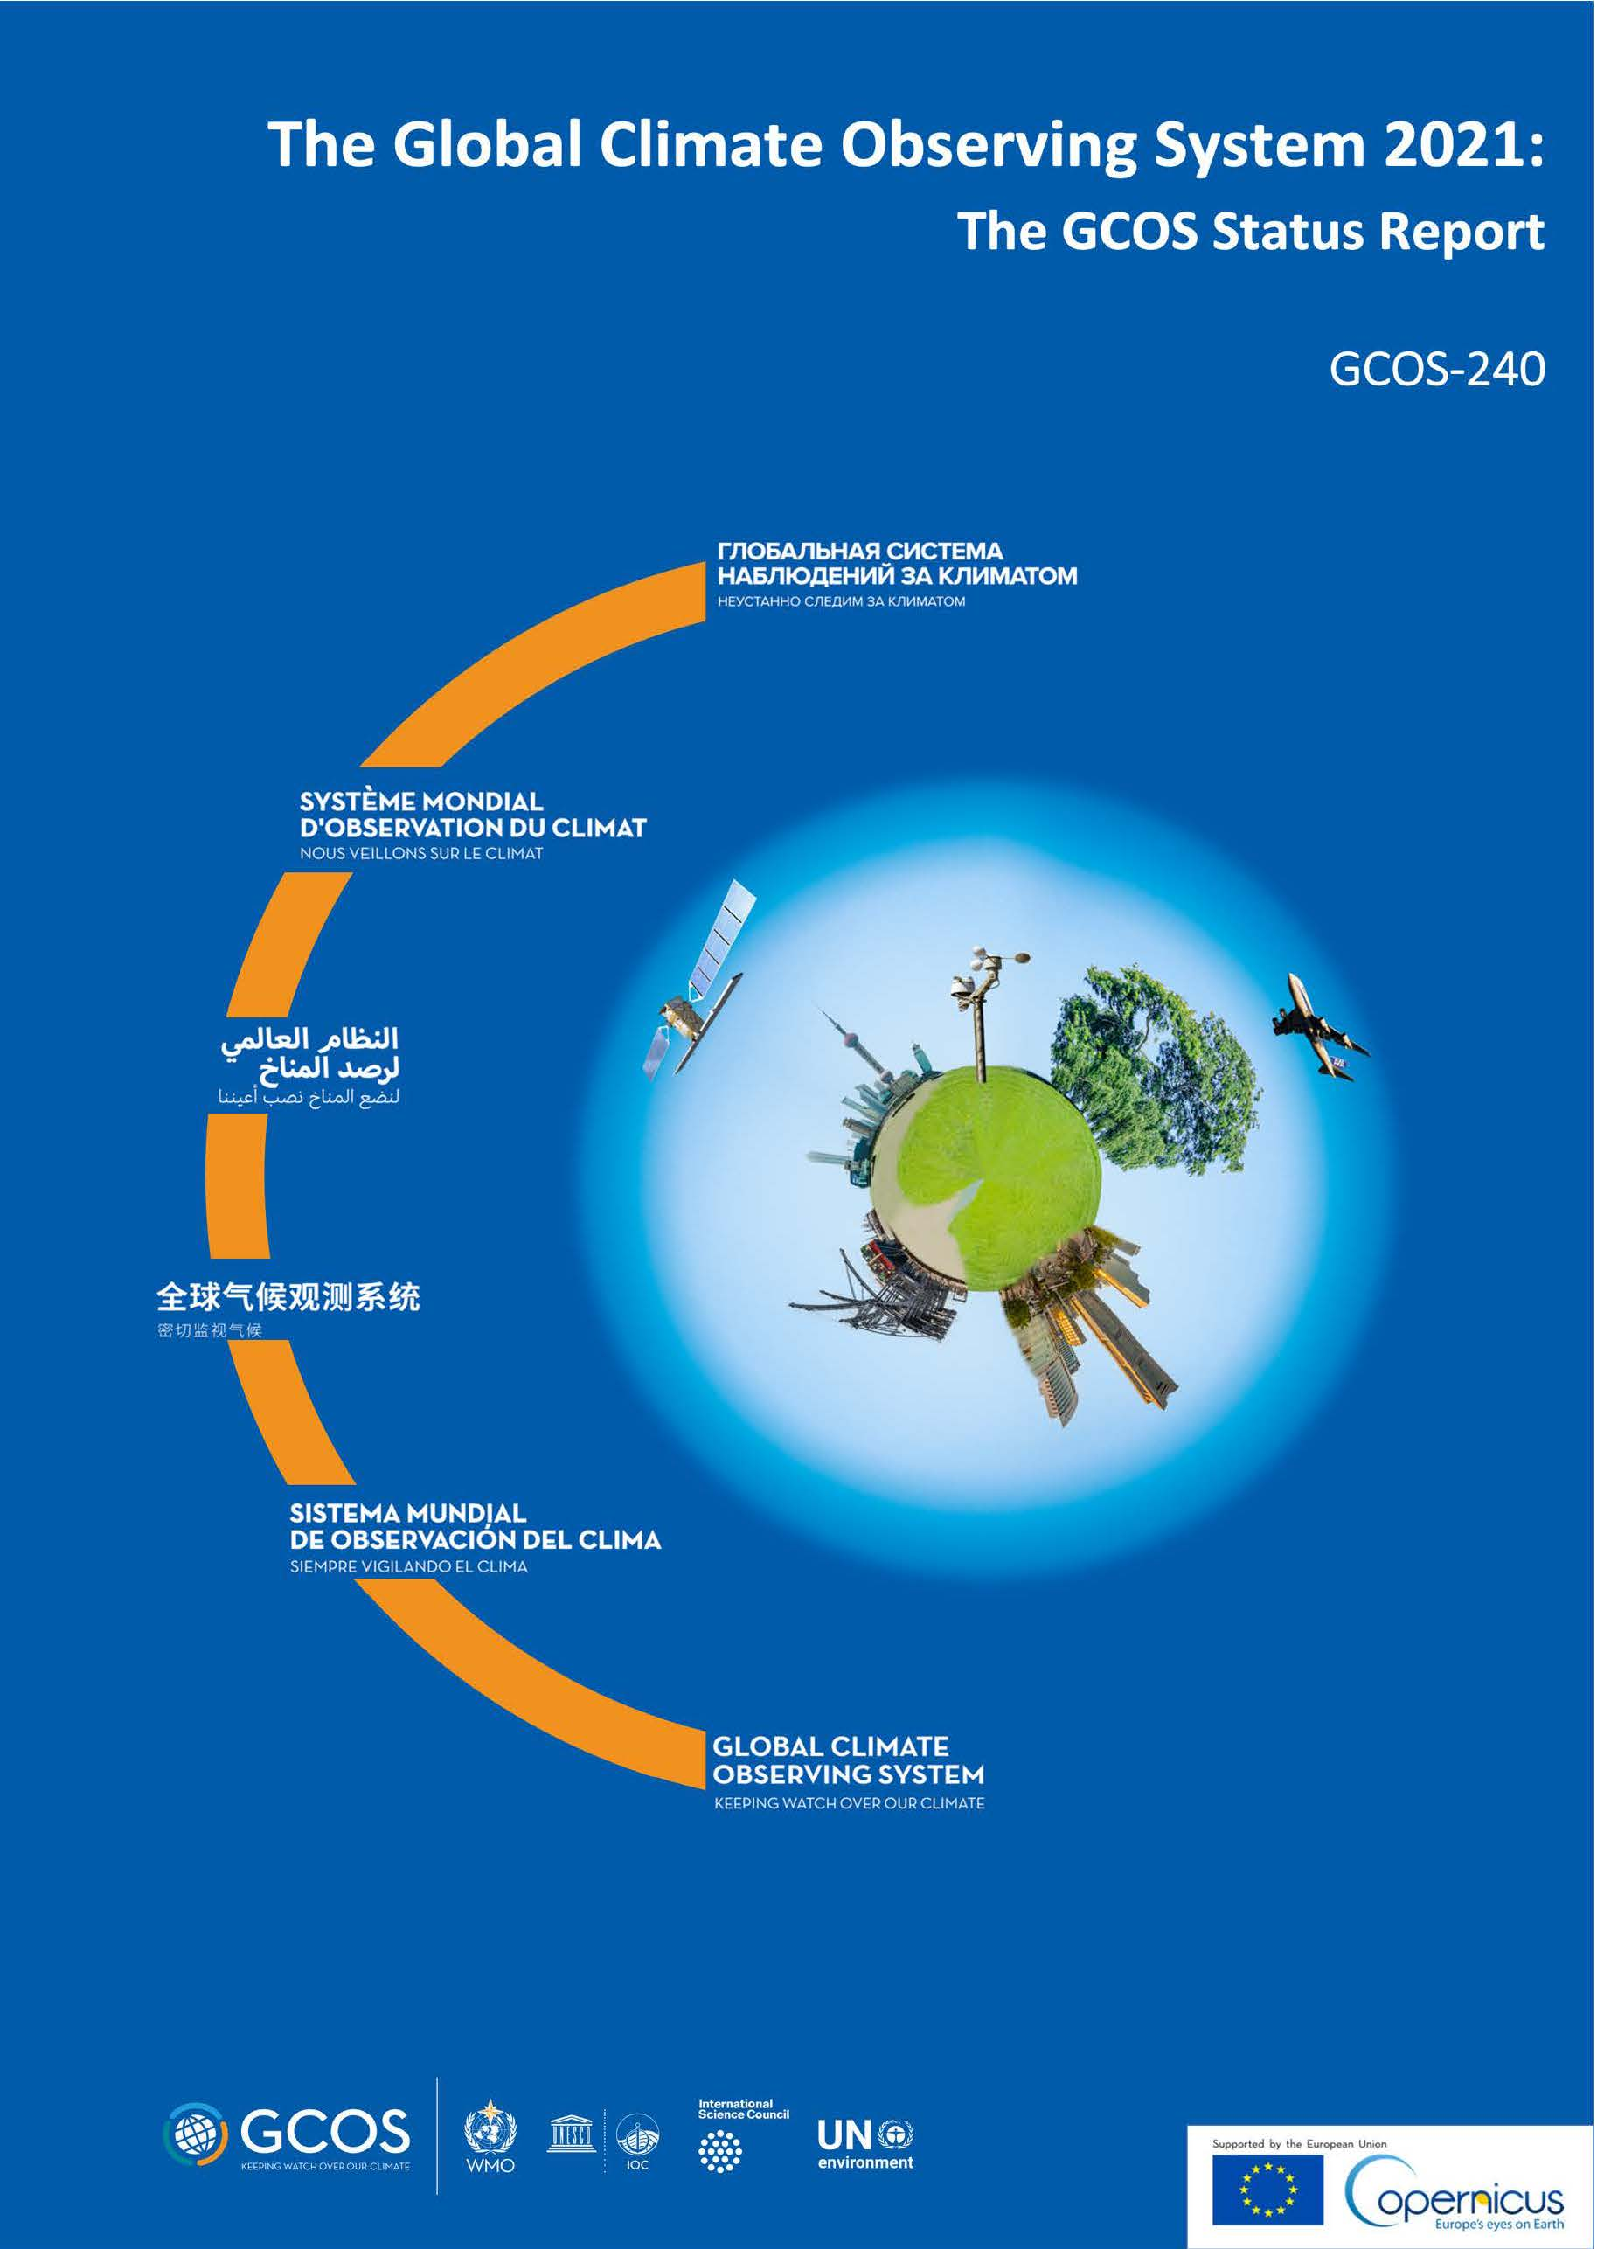
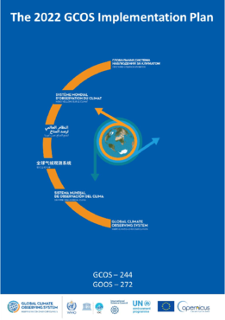
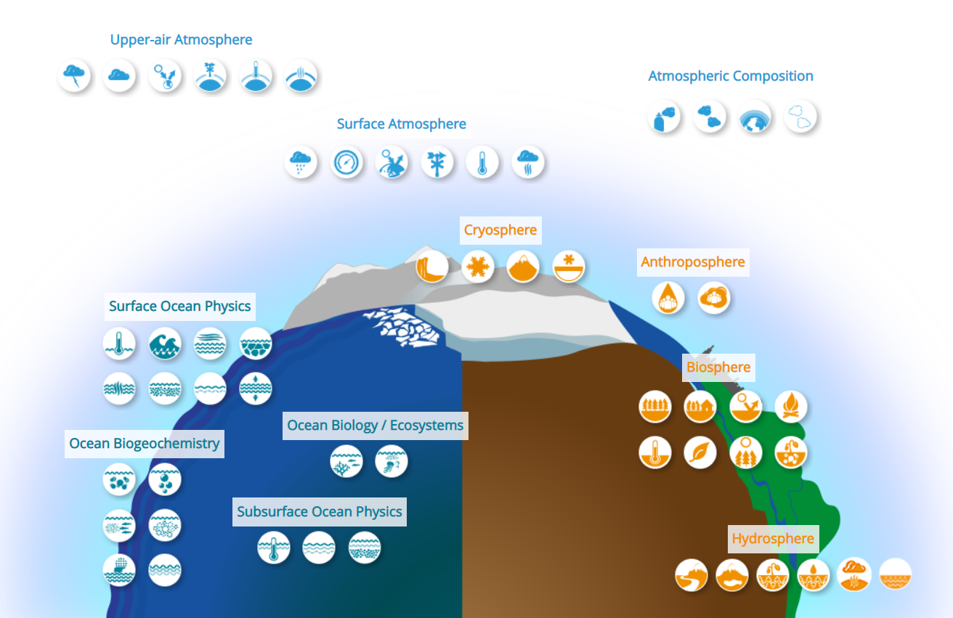
GCOS main activities and outputs
UNFCCC
Assess if the Status of the observing system for climate meets those requirements
(GCOS Status Report)
Propose actions to improve the observing system for climate
(GCOS Implementation Plan)
Identify what we need to measure (ECV requirements)

Slide 9
GCOS and INFCOM: many joint activities and functional connections
GCOS networks included in WIGOS Manual
GCOS promoting the concept of Tiered Networks
GCOS involved in the expansion of GBON
GCOS in charge of Climate monitoring requirements in RRR
GCOS involved in the development and implementation of WMO Data Policy (climate data)
GCOS strongly connected to G3W, a pillar for its implementation
GCOS in charge of sections of WIGOS manual concerning climate monitoring

Slide 10
GCOS and INFCOM: many joint activities and functional connections
GCOS networks included in WIGOS Manual
GCOS promoting the concept of Tiered Networks
GCOS involved in the expansion of GBON
GCOS in charge of Climate monitoring requirements in RRR
GCOS involved in the development and implementation of WMO Data Policy (climate data)
GCOS strongly connected to G3W, a pillar for its implementation
GCOS in charge of sections of WIGOS manual concerning climate monitoring
GCOS Chair is part of INFCOM Management Team. GCOS Panel Chairs contributing to activities (e.g. Tiered Networks, Oceanic pilot) running under SC-ON. GCOS experts involved in several INFCOM expert groups (GBON ocean, RRR, TT-EarthHydroNet…)

Slide 11
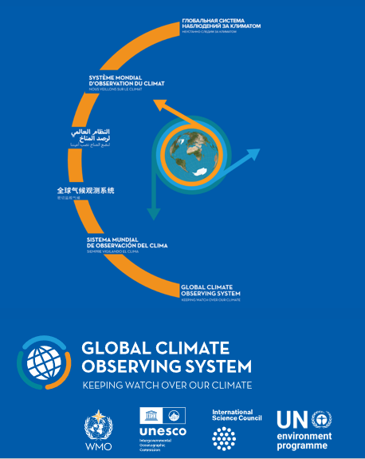
Key messages
WIGOS and GCOS intersect and complement each other
GCOS multi-domain nature supports WMO Earth System Approach
GCOS is effectively integrated into INFCOM activities, specially within WIGOS
Importance of aligning priorities and vision of INFCOM and GCOS

Slide 12
Thank you.
^{wmo.int}

